Slide 1




Astronomy 1010 chapter 28
Clayton State University
Slides for Astronomy textbook from OpenStax
https://openstax.org/books/astronomy/

Slide 2
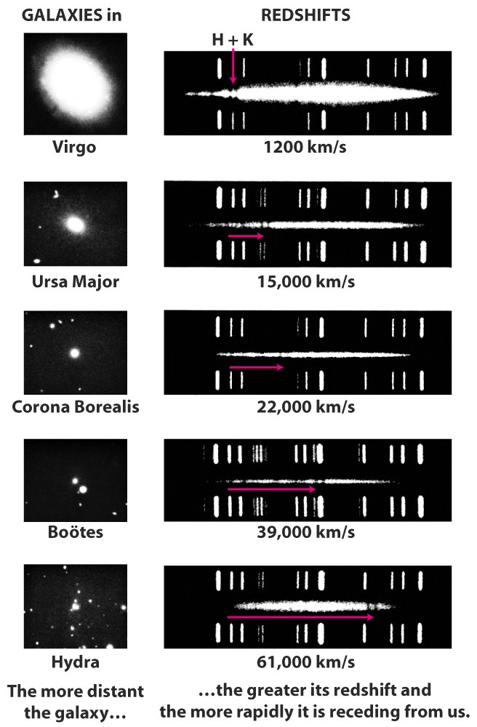
The Hubble law relates the redshifts of remote galaxies to their distances from the Earth
There is a simple linear relationship between the distance from the Earth to a remote galaxy and the redshift of that galaxy (which is a measure of the speed with which it is receding from us)

Slide 3
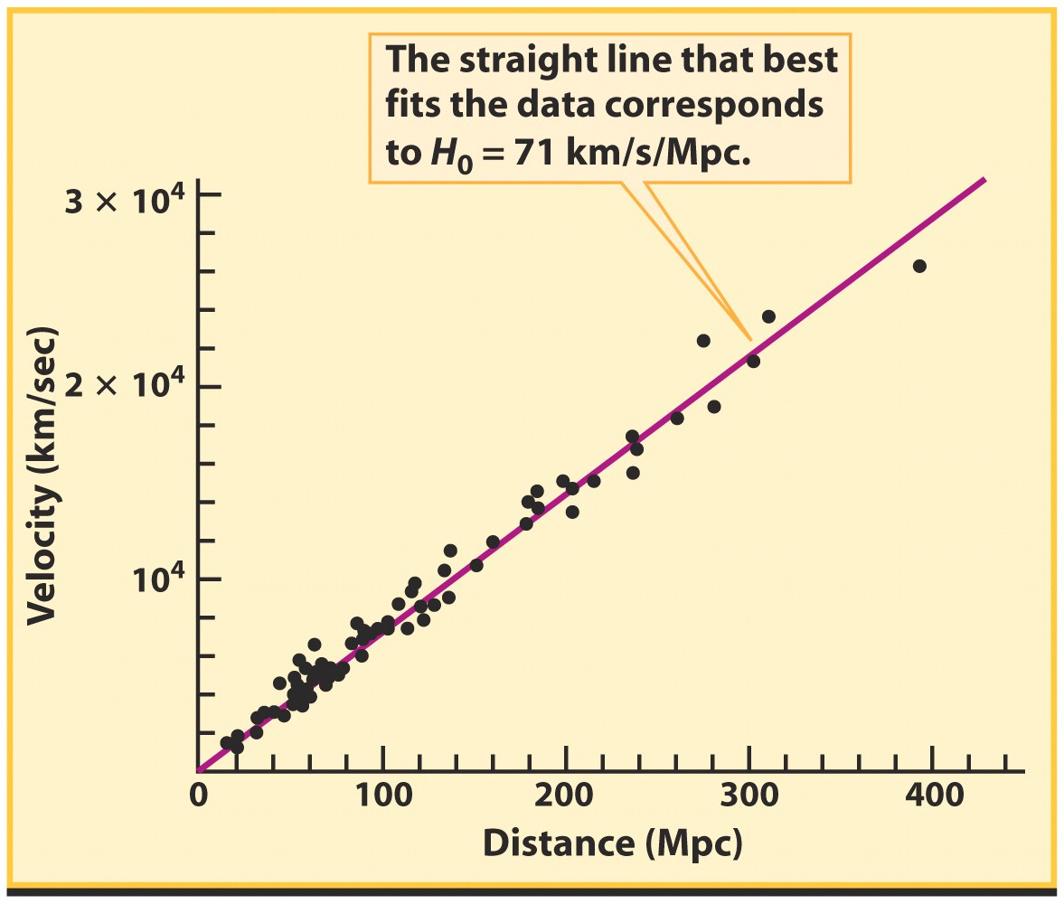
The Hubble law is v = H₀d
The value of the Hubble constant, H₀, is not known with certainty but is close to 71 km/s/Mpc

Slide 4
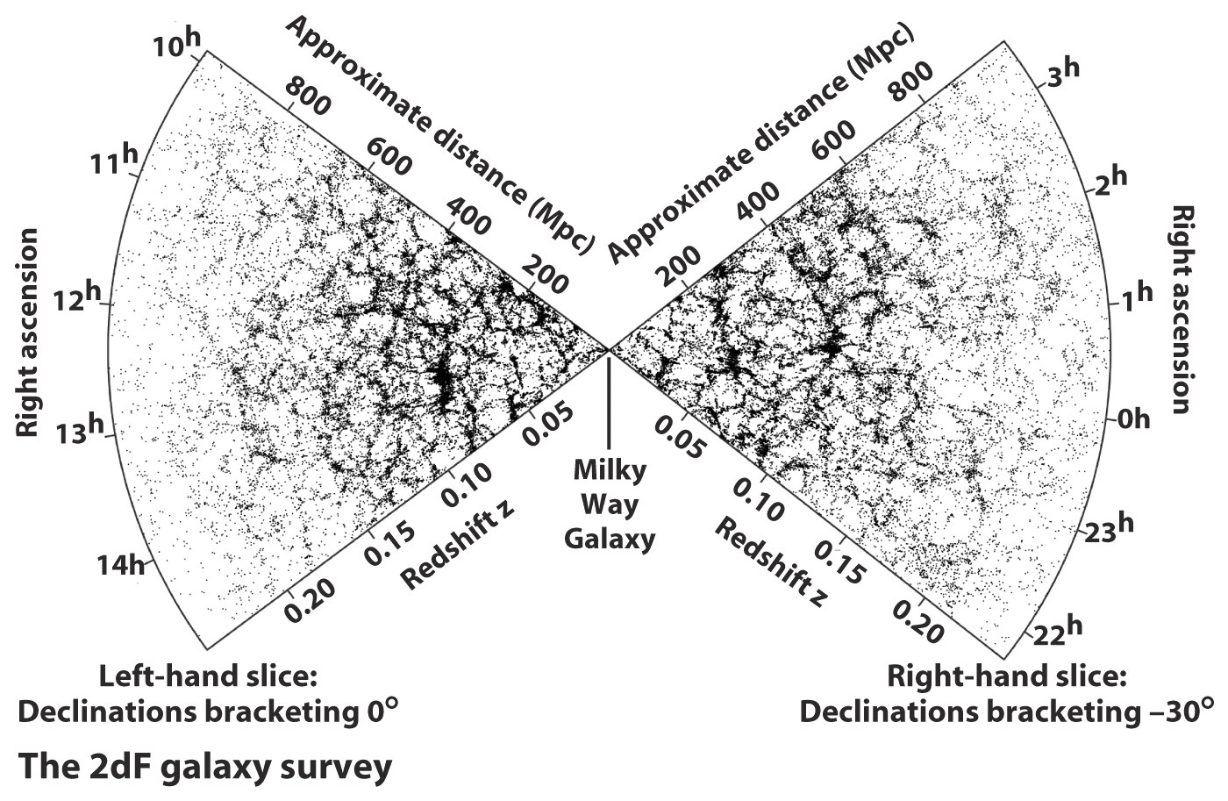
Galaxies are grouped into clusters and superclusters
Galaxies are grouped into clusters rather than being scattered randomly throughout the universe

Slide 5
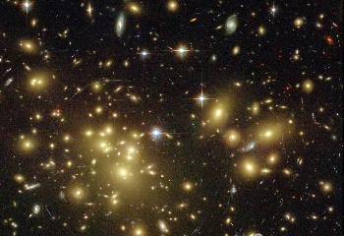
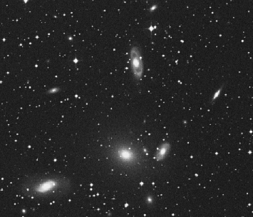
• Cluster: concentration of more than ~50 galaxies
diameter > ~1.5 Mpc/h
mass > ~3·10¹⁴ M_{O}
• Groups: smaller concentrations
mass ~3·10¹³ M_{O}

Slide 6
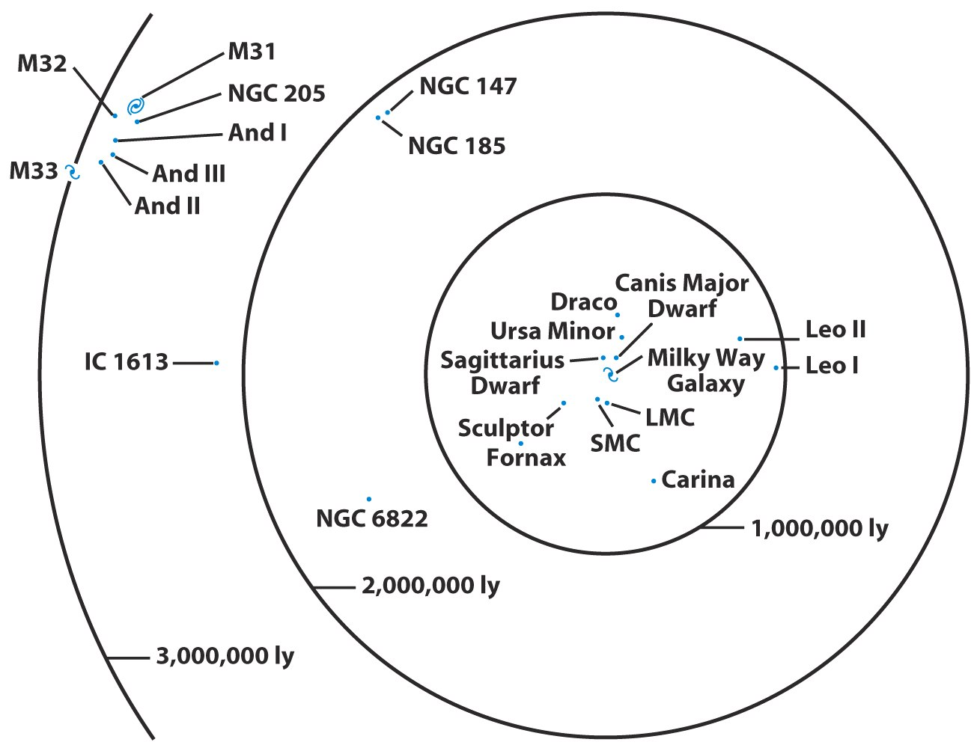
Our Galaxy is a member of a poor, irregular cluster called the Local Group

Slide 7
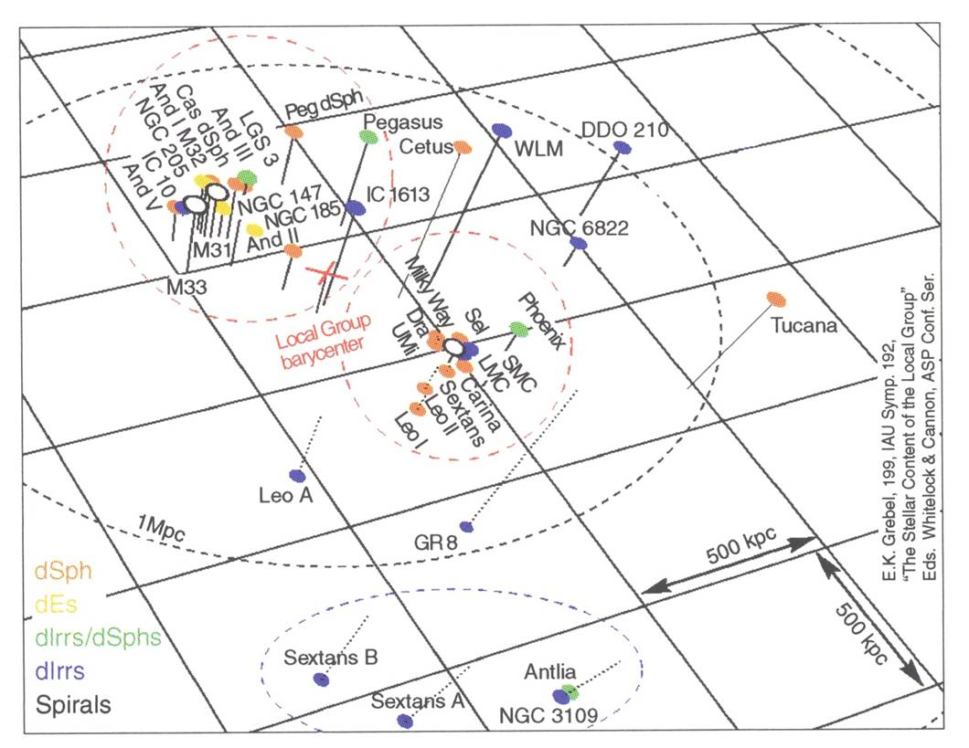
The local group

Slide 8
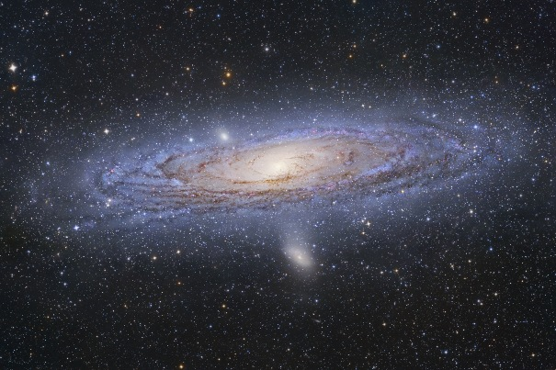
Local group - M 31 – M 32 – NGC 205

Slide 9
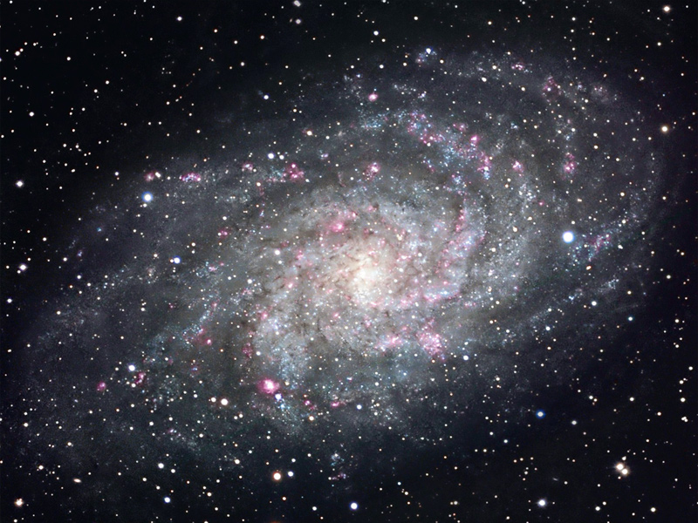
Local group - Galaxy M 33

Slide 10
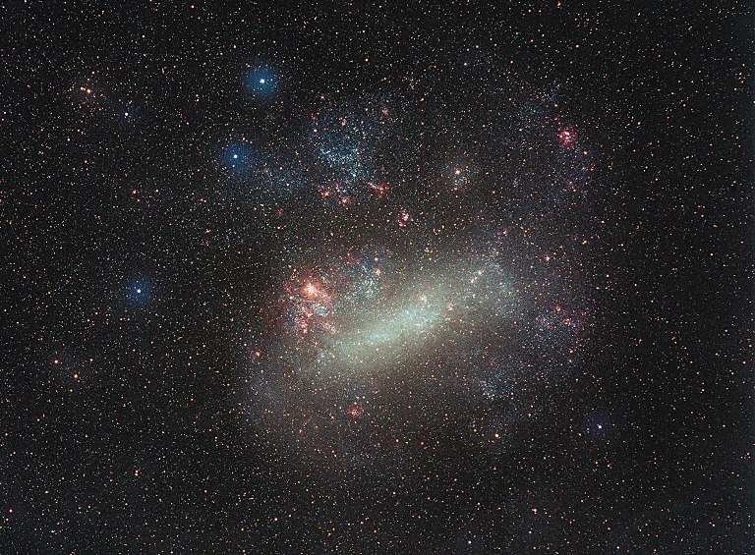
Local group -The Large Magellanic Cloud (LMC)

Slide 11
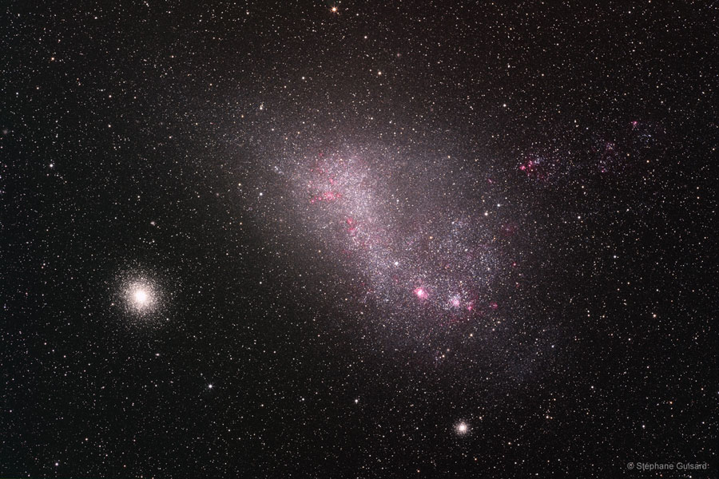
Local group - The Small Magellanic Cloud (SMC)

Slide 12
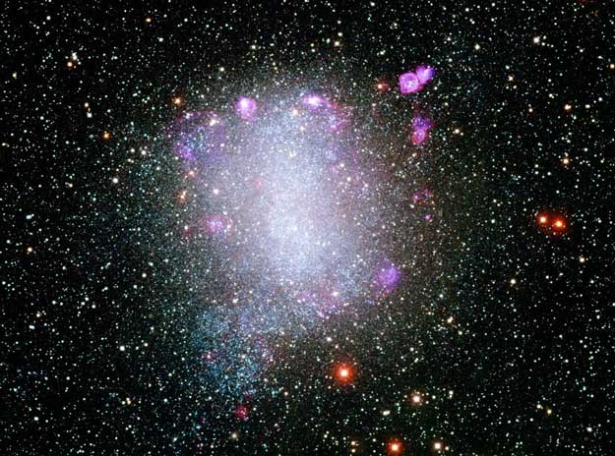
Local group - NGC 6822

Slide 13
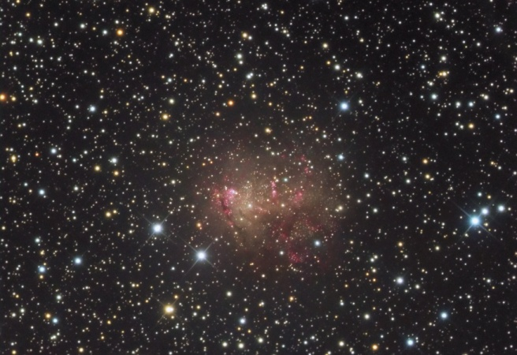
Local group - IC 10

Slide 14
• cluster ↔ overdensity of galaxies in a given solid angle
• if one orders galaxies from the brightest to the faintest one → m_{k} = magnitude of the k^{th} brightest cluster galaxy
Abell criterion (1958)
A cluster of galaxies is a concentration of:
– more than 50 galaxies with magnitude m: m₃ < m < m₃+2
– in a circle of angular radius θ_{a} < 1΄.7/z
(in the Abell catalogue, z is estimated from m₁₀, assumed identical in all clusters)
Galaxy clusters

Slide 15
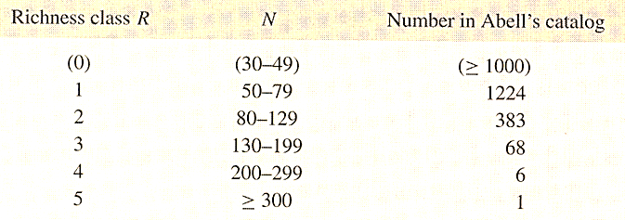
Abell catalogue – Galaxy clusters
• built from visual inspection of photographic plates
• covers 2/3 of the sky
• z < 0.2

Slide 16
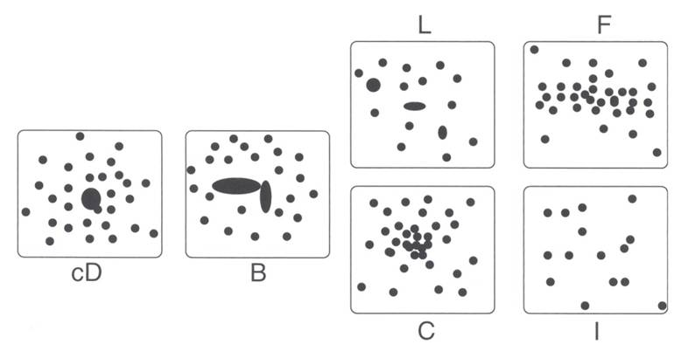
Morphological classification of Galaxy clusters
cD: galaxy in the center B: 2 bright galaxies in center L: alignment of dominant galaxies F: oblate shape without dominant galaxy C: nucleus with >4 bright gal. I: irregular
évolution
• regular clusters: more compact, more ellipticals, higher central density (→ evolved clusters)
• irregular clusters: more open, more spirals, less dense (→ clusters in formation process)

Slide 17
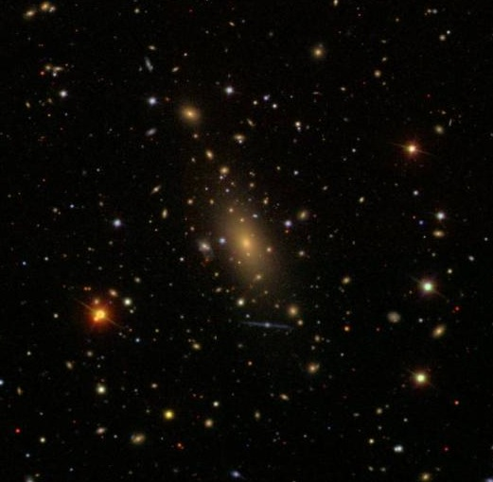
Galaxy clusters - Abell 2029 – cD

Slide 18
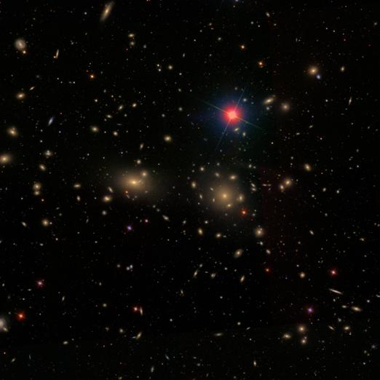
Galaxy clusters - Coma – B

Slide 19
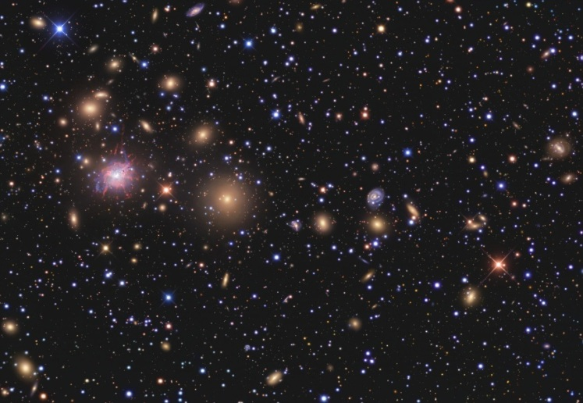
Galaxy clusters - Perseus – L

Slide 20
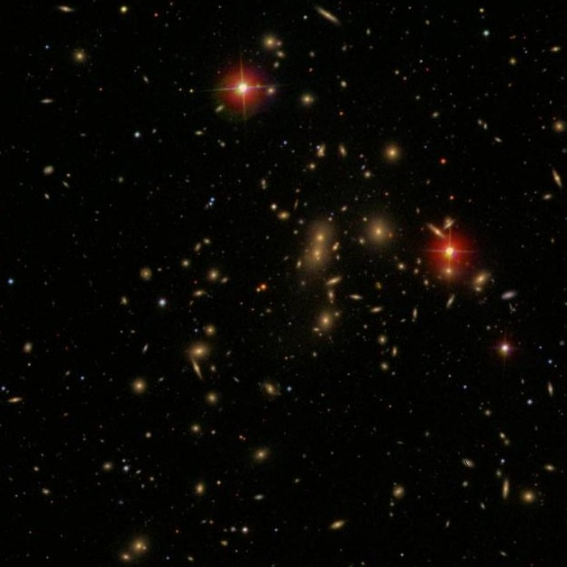
Galaxy clusters - Abell 2065 – C

Slide 21
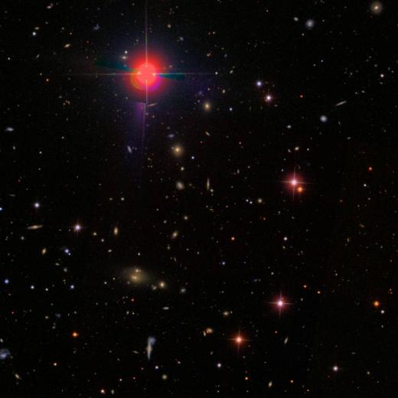
Galaxy clusters - Abell 1291 – F

Slide 22
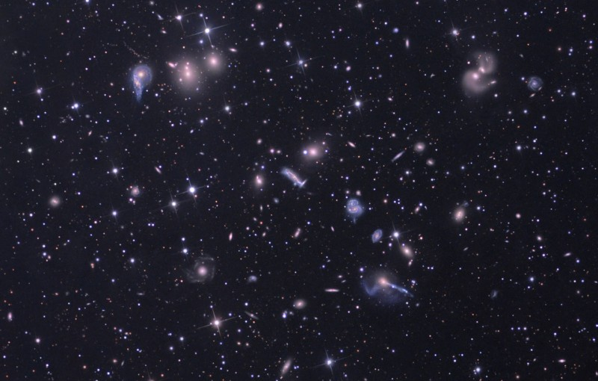
Galaxy clusters - Hercules – I

Slide 23
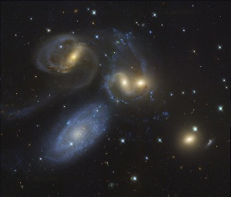
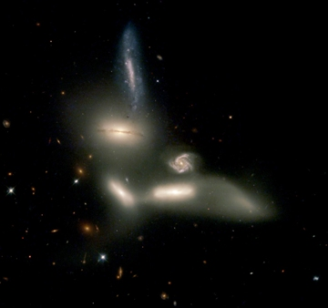
Galaxy groups
• Similar to clusters but less massive, less populated, less extended
• Compact groups:
– a few very close galaxies
– often in interaction
– X emission
– short lifetime (t_{dyn} ~ R/σ ~ 200 million years)
Stefan Quintet
Seyfert Sextet

Slide 24
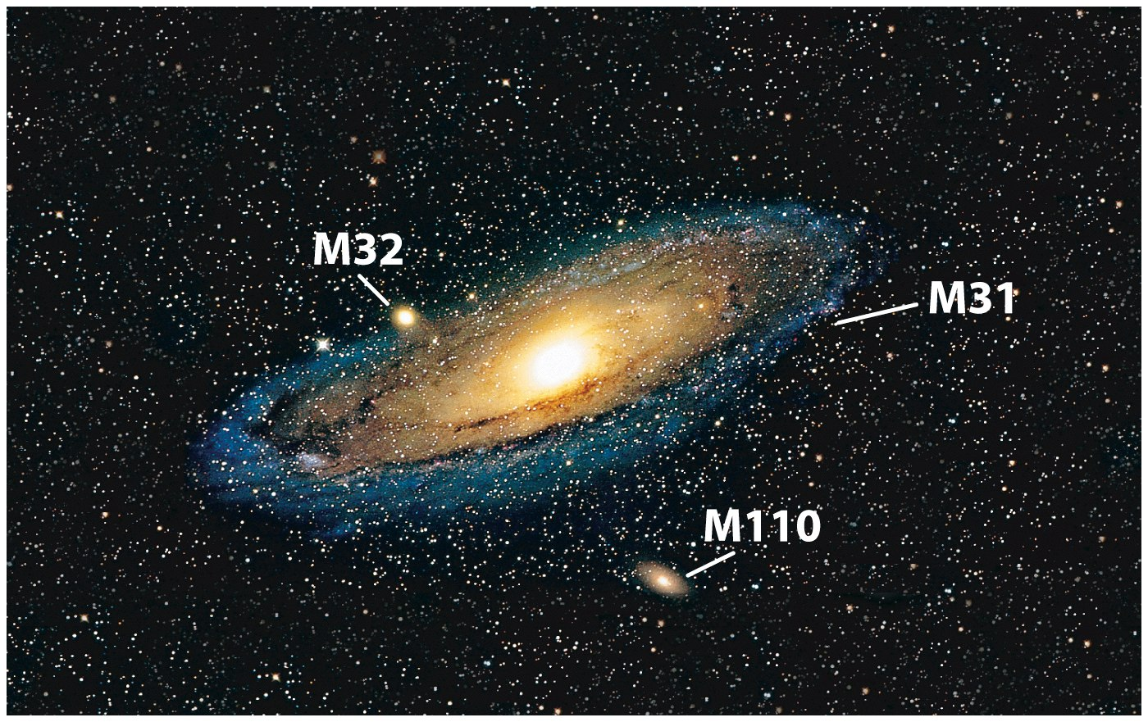
Collisions of Galaxies

Slide 25
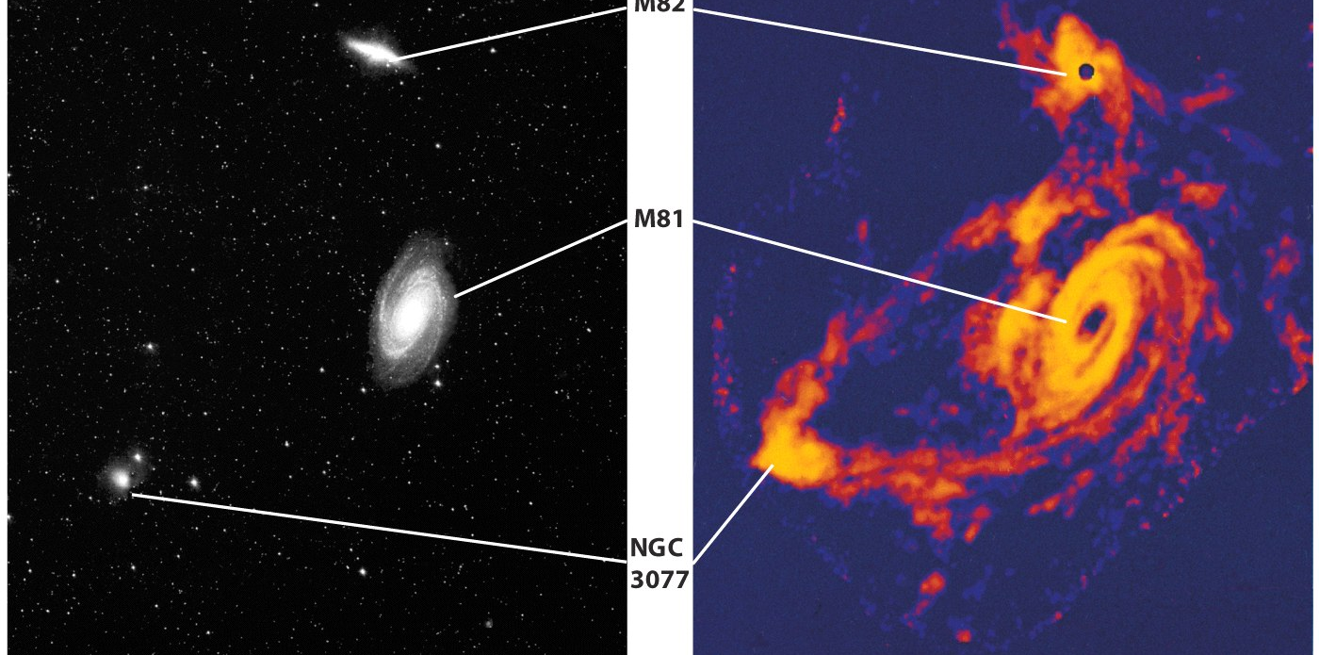
Colliding galaxies produce starbursts, spiral arms, and other spectacular phenomena
When two galaxies collide, their stars pass each other, but their interstellar media collide violently, either stripping the gas and dust from the galaxies or triggering prolific star formation

Slide 26
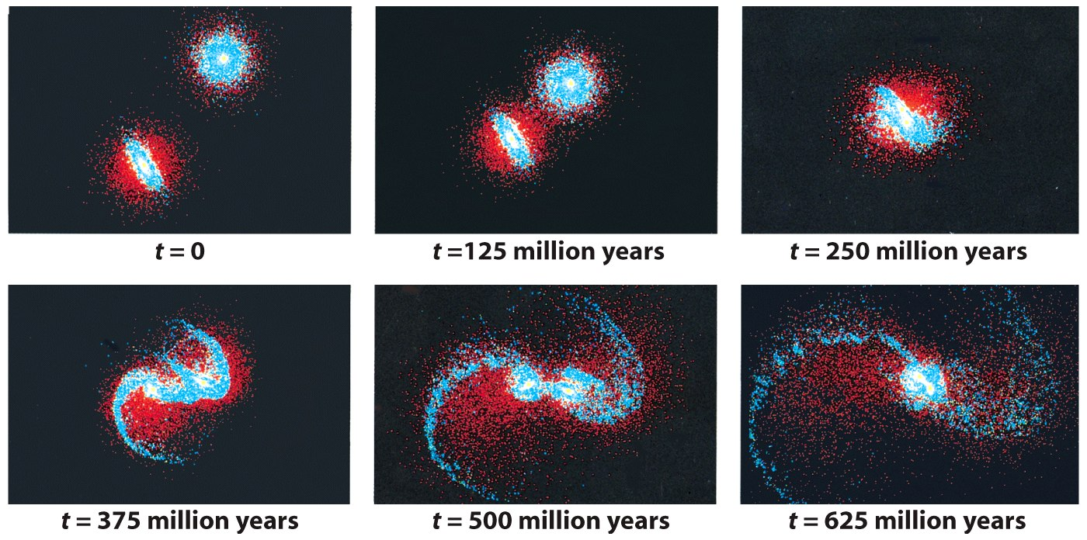
The gravitational effects during a galactic collision can throw stars out of their galaxies into intergalactic space

Slide 27
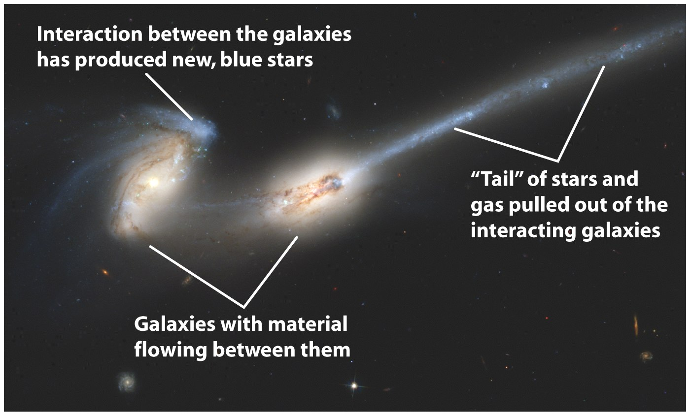

Slide 28
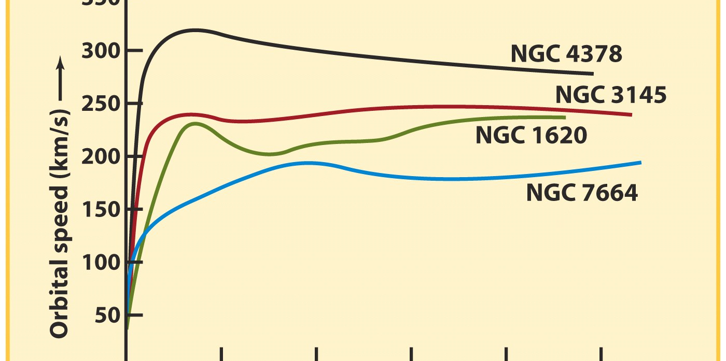
Most of the matter in the universe has yet to be discovered
The luminous mass of a cluster of galaxies is not large enough to account for the observed motions of the galaxies; a large amount of unobserved mass must also be present
This situation is called the dark-matter problem

Slide 29
Dark Matter halos
Hot intergalactic gases in rich clusters account for a small part of the unobserved mass
These gases are detected by their X-ray emission
The remaining unobserved mass is probably in the form of dark-matter halos that surround the galaxies in these clusters

Slide 30
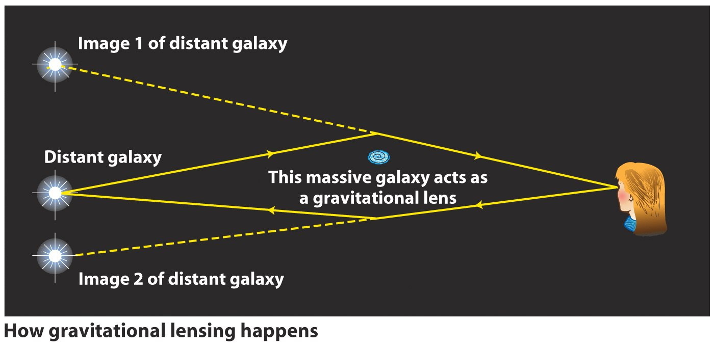
Gravitational lensing of remote galaxies by a foreground cluster enables astronomers to glean information about the distribution of dark matter in the foreground cluster

Slide 31
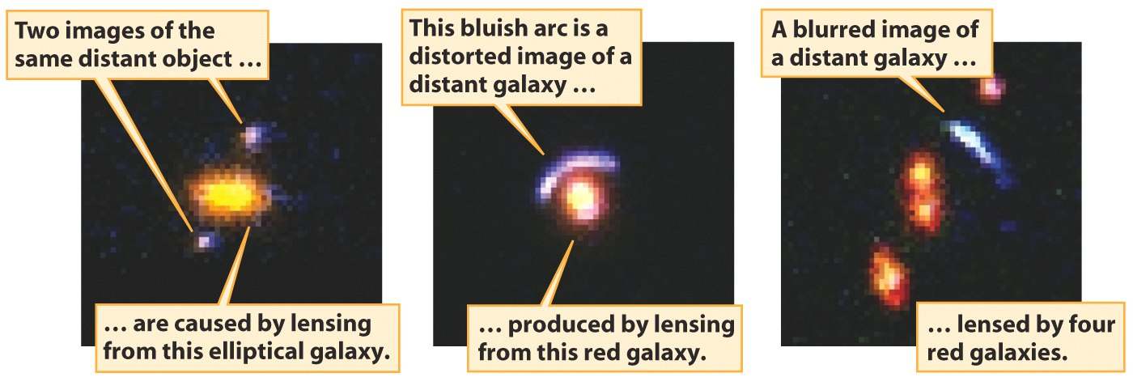

Slide 32
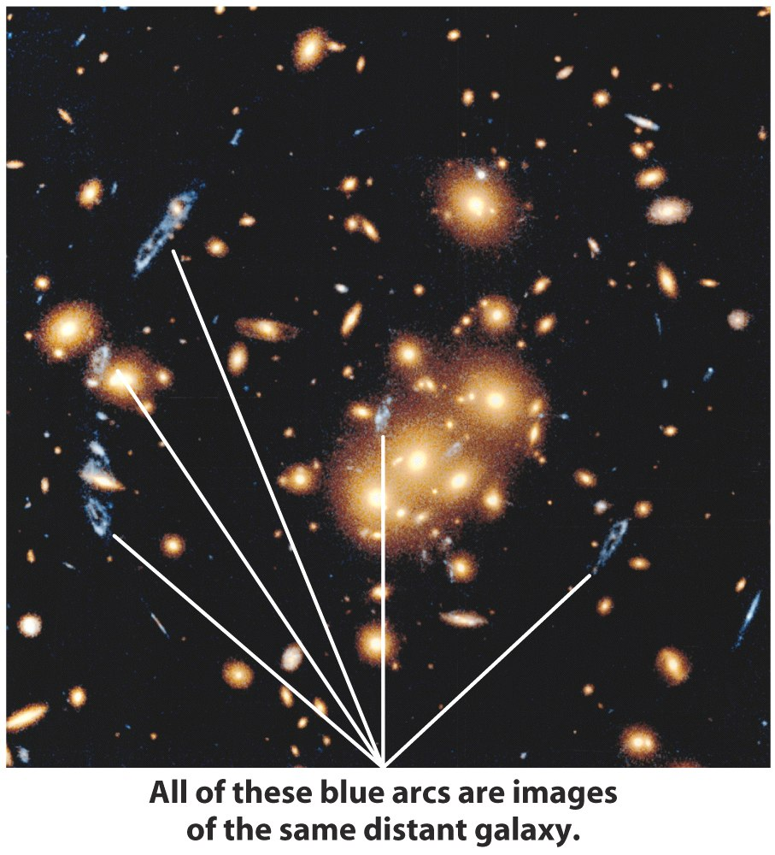

Slide 33
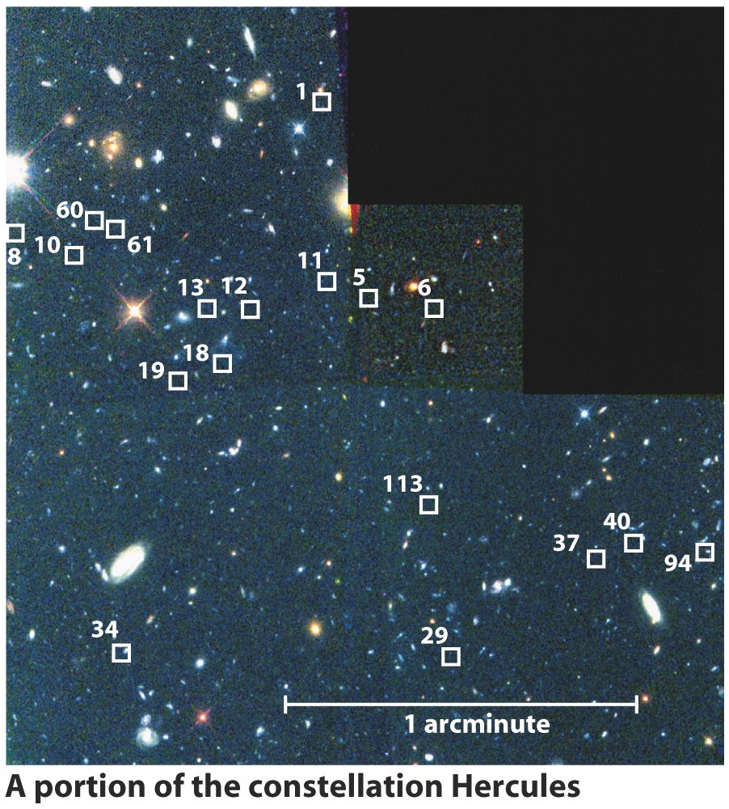
Galaxies formed from the merger of smaller objects
Observations indicate that galaxies arose from mergers of several smaller gas clouds
A large galaxy in a rich cluster may tend to grow steadily through galactic cannibalism, perhaps producing in the process a giant elliptical galaxy

Slide 34
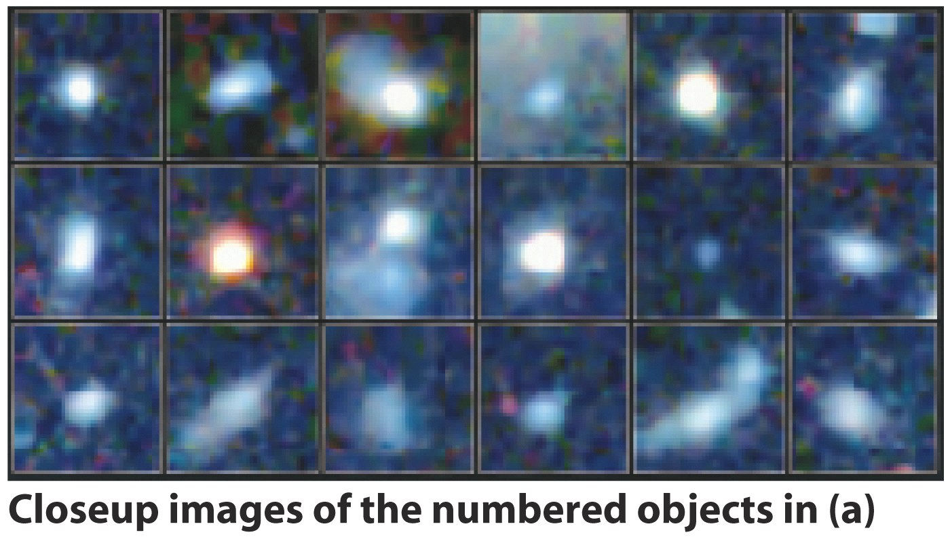

Slide 35
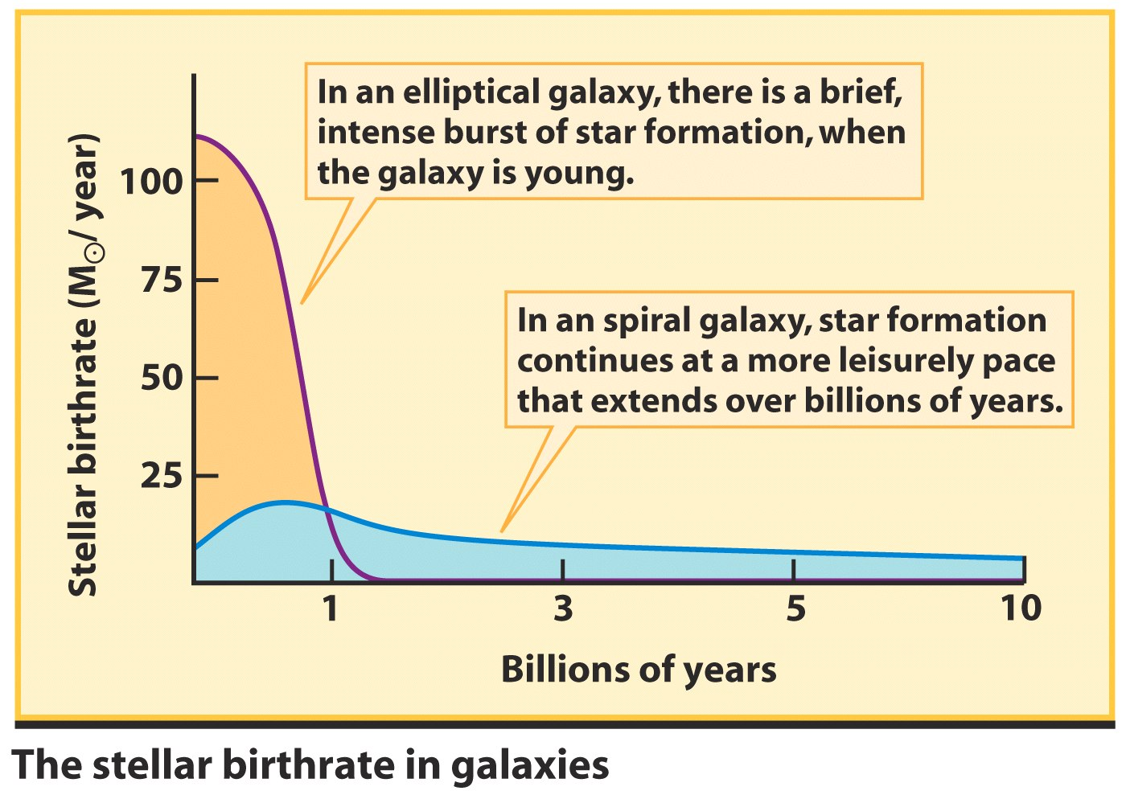
Whether a protogalaxy evolves into a spiral galaxy or an elliptical galaxy depends on its initial rate of star formation

Slide 36
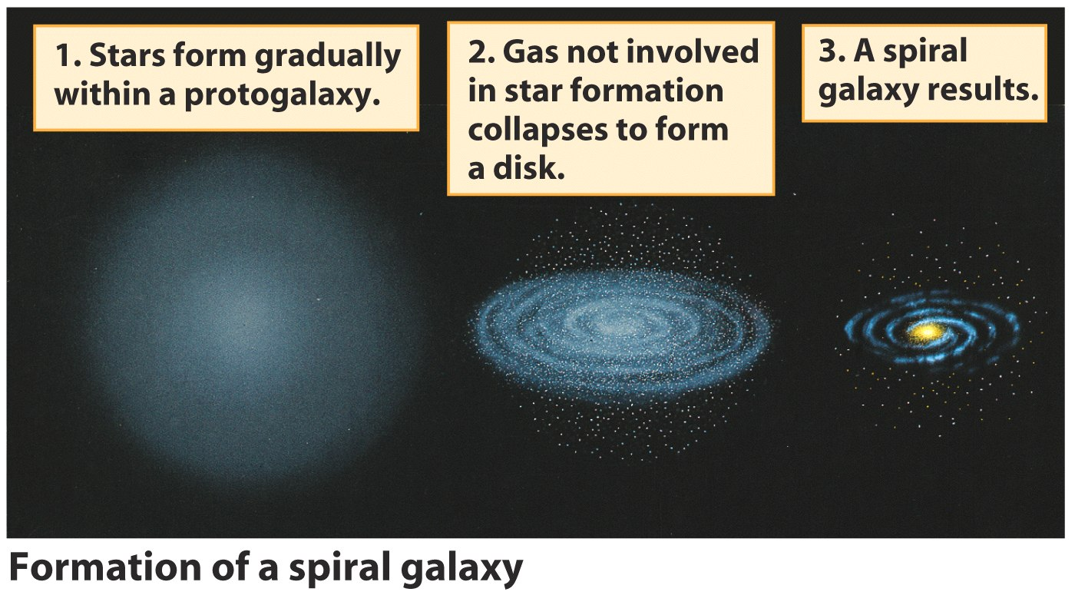

Slide 37
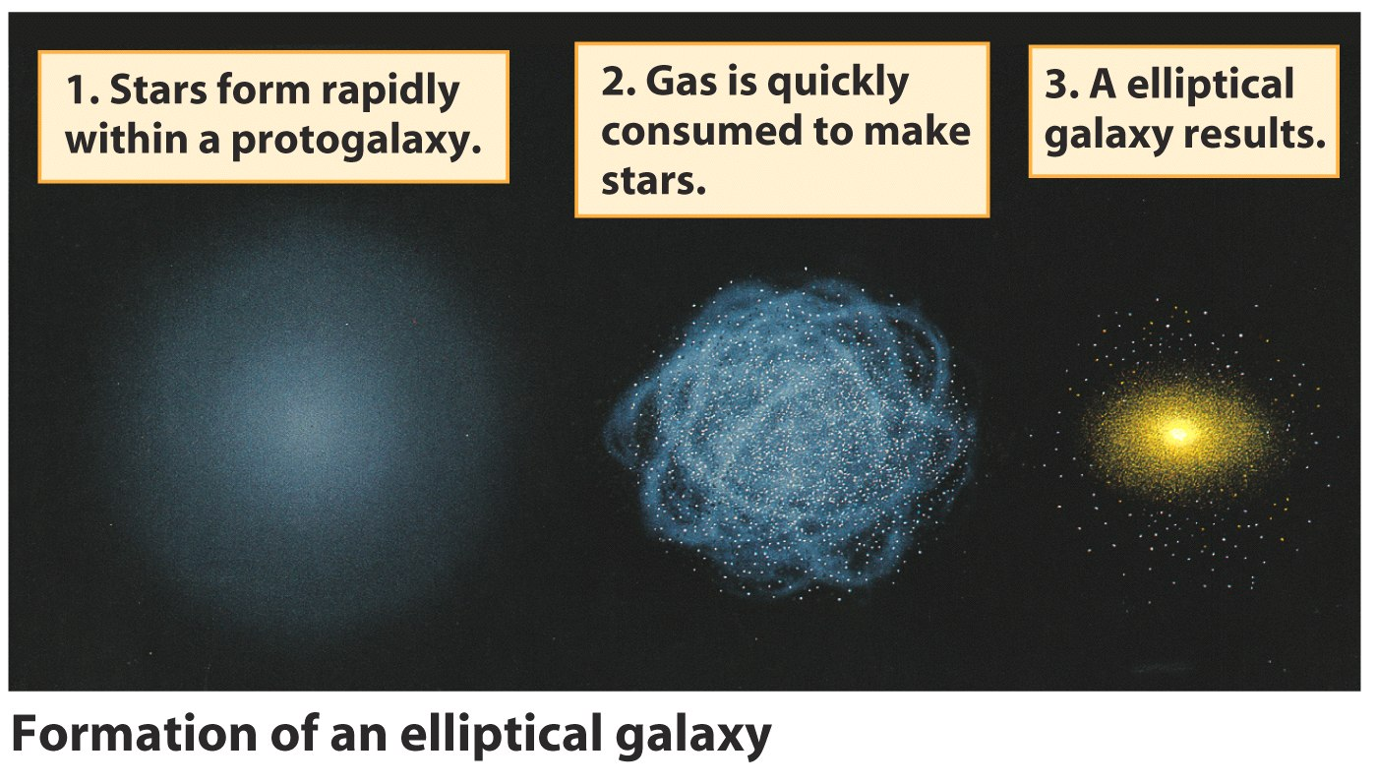

Slide 38
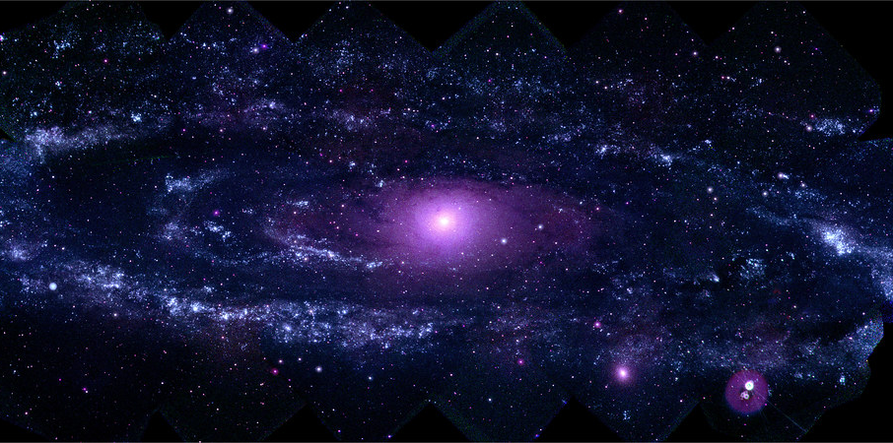
Any Questions?
Andromeda galaxy in UV light

